Slide 1

Postman: The Ultimate Tool for API Testing and Automation – Part 1

Slide 2
Agenda
What is API?
Postman Introduction
Use cases
Building Blocks
Request Builder
Workspace
Collection
Environments
HTTP Request
HTTP Methods
Sending HTTP Request
Validate Response
Scripting
API Testing

Slide 3
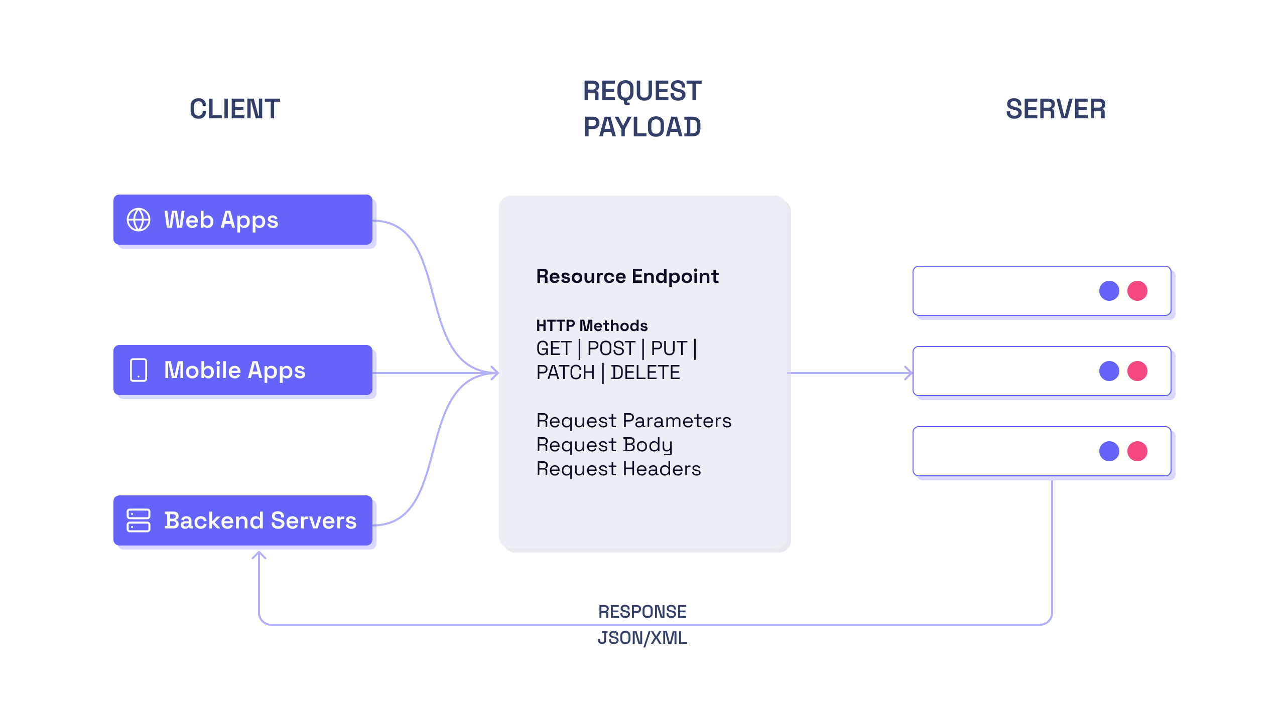
What is API?
APIs are an essential part of modern software development, enabling communication and data exchange between different applications, systems, and platforms.

Slide 4
API Testing
What?
API testing involves verifying the functionality, reliability, performance, and security of an application programming interface (API).
It can include testing individual API endpoints, as well as testing the API as a whole to ensure all components work together as expected.
API testing can be performed manually or through automated testing tools.
Why?
It helps to identify issues and defects early in the development cycle.
It ensures that the API works as expected and meets the business requirements.
It helps to improve the quality and reliability of the API.
It helps to ensure that the API is secure and protects sensitive data.
It helps to reduce the cost and time of development by catching issues early.

Slide 5

Postman Introduction
Postman is a must-have tool for anyone involved in API development! Whether you're a developer, tester, or technical writer, Postman simplifies the API development process and makes it easy to design, test, and document your APIs.

Slide 6

Use cases
👨‍💻 Developers can use Postman to create and test API endpoints, input required parameters, and identify any issues or bugs.
🕵️ Testers can use Postman to create and execute API tests and ensure the response status codes, response time, and response body meet the requirements.
📝 Technical writers can use Postman to create API documentation and test different endpoints to include screenshots of the responses in the documentation.

Slide 7
Use cases
👨‍💼 Operations teams can use Postman to monitor APIs and ensure that they are functioning correctly.
👷 Integration teams can use Postman to test APIs before integrating them with other systems.

Slide 8
Building Blocks
Request Builder: Create and send requests without coding by selecting request type, inputting URL, headers, and body parameters.
Workspace: Organize and manage requests, collections, and environments for API development and testing workflows.
Collection: Group requests, scripts, and tests in a single folder to efficiently organize and manage them. Shareable for collaboration.
Environments: Configure requests based on different environments with sets of variables such as development, staging, and production.

Slide 9
HTTP Request: Methods
GET: Retrieve data from the server, safe and idempotent, used to fetch information.
POST: Create new resources on the server, not idempotent, used to add new data.
PUT: Update existing resources on the server, idempotent, used to modify data.
DELETE: Remove resources from the server, idempotent, used to delete data.
PATCH: Update specific fields in an existing resource on the server, idempotent, used to modify specific data.
HEAD: Retrieves only the headers of the response without the actual response body, used to check resource availability and retrieve metadata.

Slide 10
Sending HTTP Request
To send an HTTP request in Postman, simply select the request method you want to use, input the necessary parameters, and click the "Send" button.

Slide 11
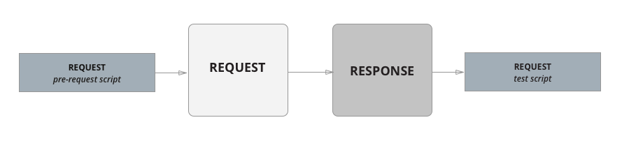
Scripting
Before a request is sent to the server, as a pre-request script under the Pre-request Script tab.
After a response is received, as a test script under the Tests tab.

Slide 12
Validate Response
Postman's Tests feature allows users to validate the response of an API request and ensure that it meets the expected requirements.
Tests are written in JavaScript and can be used to check the response status code, response time, and response body.
Postman provides several types of assertions that can be used to validate API responses.

Slide 13
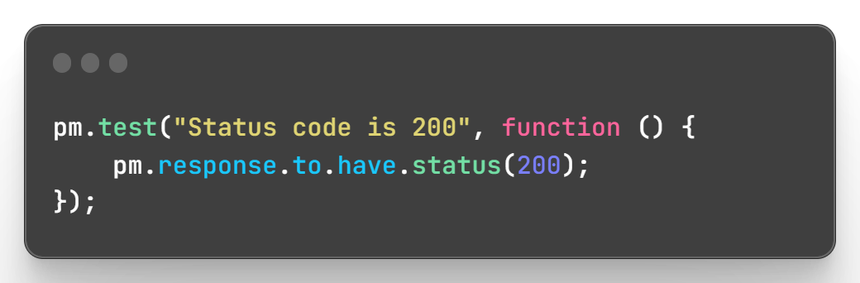
Status Code Assertion
Verify the expected HTTP status code in the response. For example, you can assert that a GET request to a user endpoint should return a 200 status code.

Slide 14
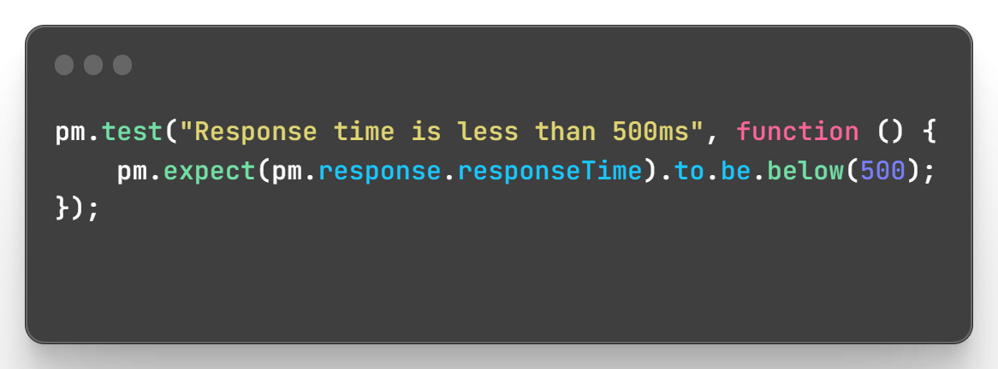
Response Time Assertion
Verify the expected response time in milliseconds. For example, you can assert that a GET request to a user endpoint should return a response time less than 500ms.

Slide 15
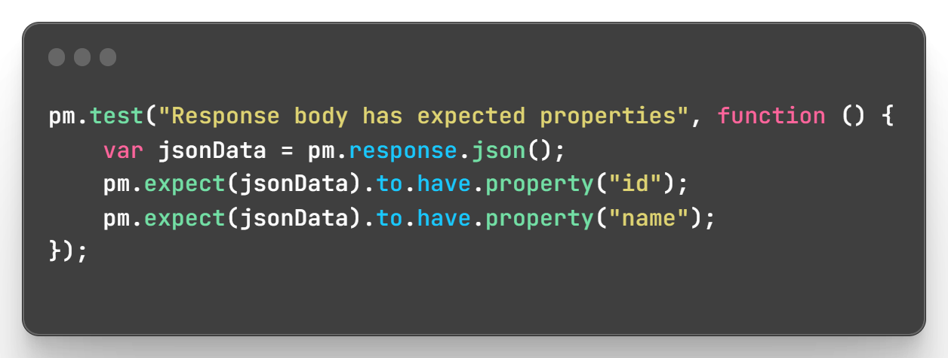
Response Body Assertion
Verify the expected content in the response body. For example, you can assert that a GET request to a user endpoint should return a user object with the expected properties.

Slide 16
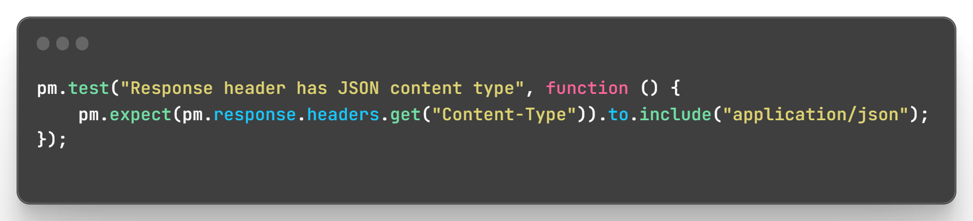
Response Headers Assertion
Verify the expected headers in the response. For example, you can assert that a GET request to a user endpoint should return a JSON content type.

Slide 17
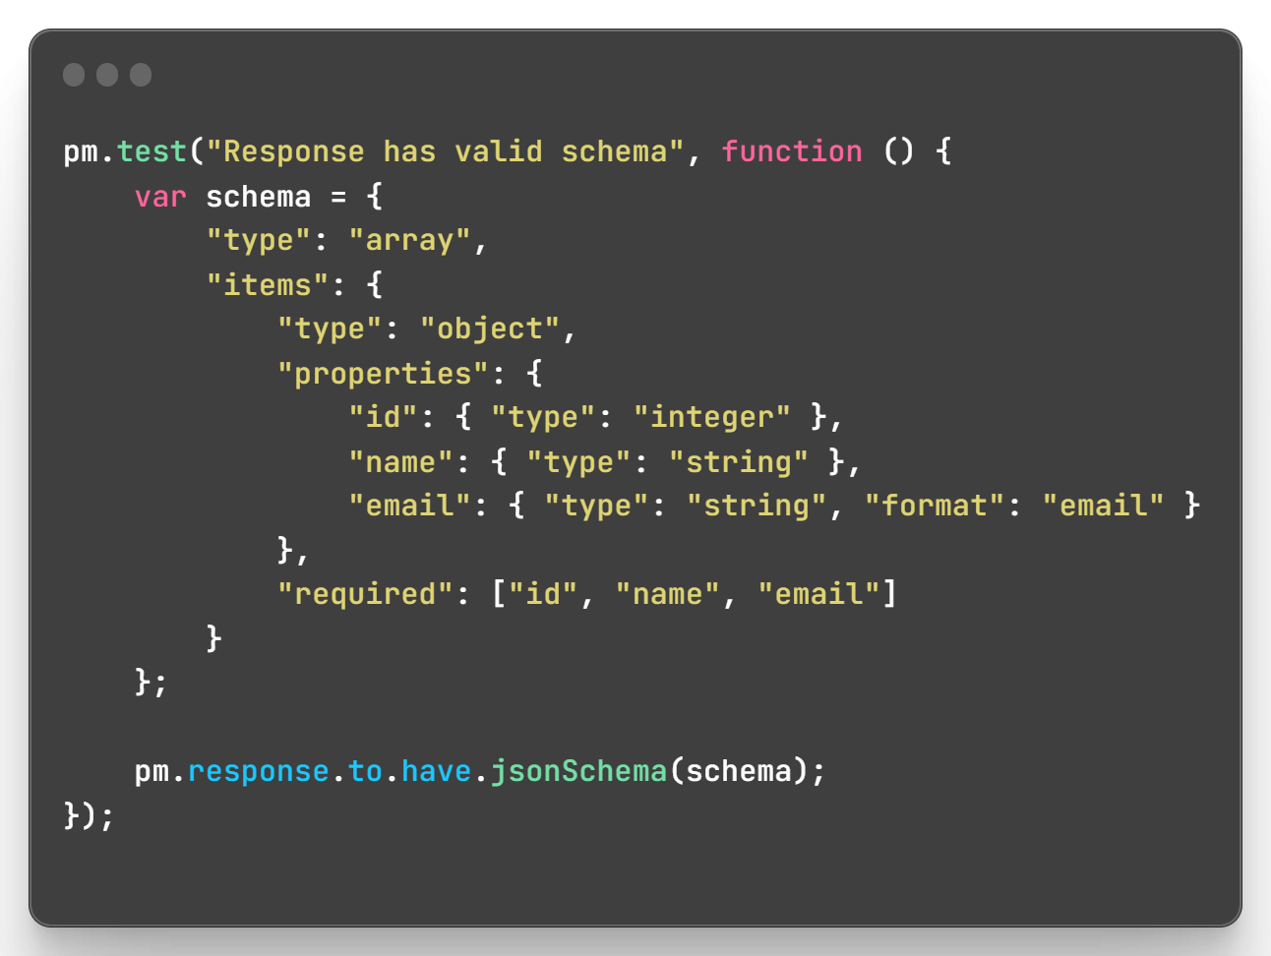
JSON Schema Assertion
Verify that a JSON response from an API conforms to a specified JSON schema. This ensures that the API contracts are honored, and that the response is in the expected format.

Slide 18
Takeaway
Postman is available as a desktop application and as a cloud-based service, making it accessible to developers anywhere.
Postman is a versatile API development tool that facilitates API design, testing, and documentation for a range of teams including developers, testers, technical writers, integration teams, and operations teams.
Postman offers a user-friendly interface for making HTTP requests and supports a wide range of HTTP methods.
Postman enables users to organize requests, collections, and environments in a workspace for efficient API development and testing workflows.
Postman supports various types of API requests, including HTTP requests, Websocket requests, gRPC requests, and GraphQL requests.
Postman's testing capabilities allow users to write custom scripts to test API endpoints.

Slide 19

Thank You

